Slide 1

SENTIMENT CLASSIFICATION WITH CUSTOM NAMED ENTITY RECOGNITION
Ganga Babu M, Daniel.V, Bhagavathi Perumal, Narendar Punithan, Pradeep Kumar S

Slide 3
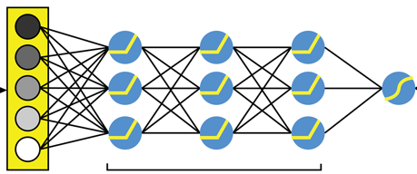

Class
Negative
Partially Negative
Neutral
Partially Positive
Positive
Pre-Processing
Sentiment
Websites: YELP, IMDB
Dense Embeddings
DNN -Hidden Layer
word2Vec, KMeans, Gensim,
Rule-based NLP, TextBlob vs VADER
BERT- AutoModel : HuggingFace
Auto-tokeniser & Ktrain
Bert – Pretrained Model

